Slide 1
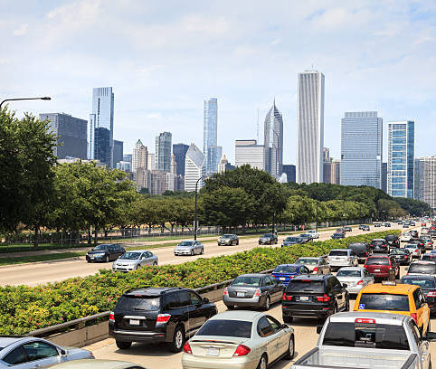
Chicago City
Prediction of Causes of Accidents

Slide 2
OVERVIEW
This presentation is divided in different parts:
Business understanding
Data understanding
Modeling
conclusion

Slide 3
Traffic congestion and accidents are a persistent problem in urban areas, particularly in large cities like Chicago. Understanding the primary causes of traffic crashes can help city planners, transportation authorities, and policymakers implement more effective measures to mitigate and reduce traffic crashes.
So, the goal is to predict the cause of crashes by using different models and to be able to understand which one of the causes are influential.
Business understanding

Slide 4
The objectives of this project are:
To understand the primary causes of accident for drivers.
To merge the 3 datasets, which are the people, the crash and the vehicles. In an understandable manner by dropping column which are considered irrelevant.
To clean the data by reducing the numbers of multiclasses for each feature.
To test different models and understand the result of each model and choose the best performing one.
Objectives

Slide 5
The methods used are:
Data collection
Data cleaning
Data modelling
Model evaluation
Methods

Slide 6
Step 1 - Developing the predictive models
Step 2 - Testing the models used. These are;
KNN,
XGBoost,
Random Forest,
Decision Tree,
ANN,
Naive Bayes.
Step 3 – Encoding of the y and x which are categorical
Step 4 – Training of the data using the different models
80% of the data was used for training the model.
Step 5 – Prediction and evaluation of the models.
Decision
Choose the best the best performing model for primary cause prediction.
Model Building

Slide 7
Comparing the Performance of the Models from the evaluation metrics to establish which model works best.
KNN
Accuracy: 87%
Weighted average:87%
Random Forest
Accuracy: 92%
Weighted average: 92%
Decision Tree
Accuracy: 86.1%
Weighted average : 70.3%
XGBoost
Accuracy: 92%
Weighted average : 92 %
ANN
Accuracy: 0.53
Weighted average : 0.56
Naive Bayes
Accuracy: 25.8%
F1 score: 26.5%
Verdict
XGBoost and Random Forest are the better performing model. XGBoost being the better one because of higher F1 score for the different categories.
Model Comparison

Slide 8
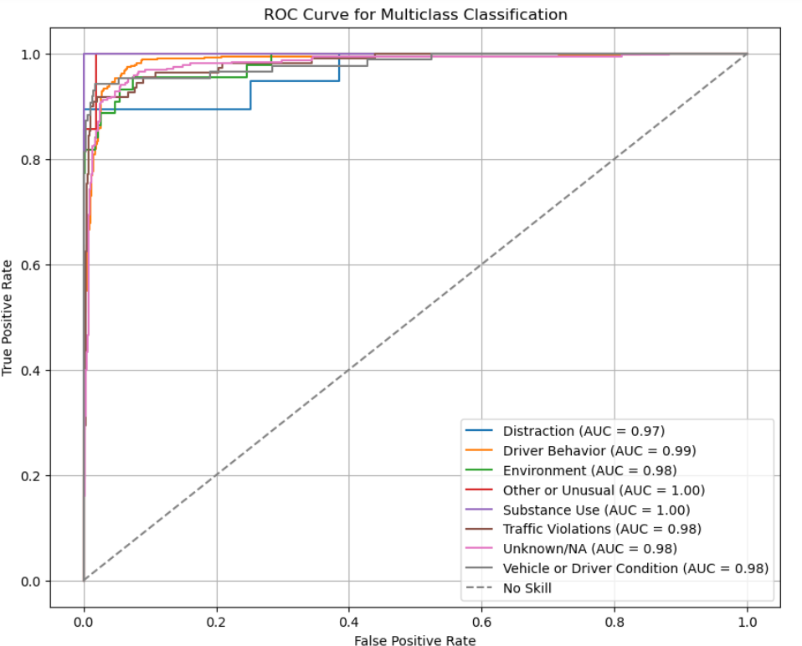
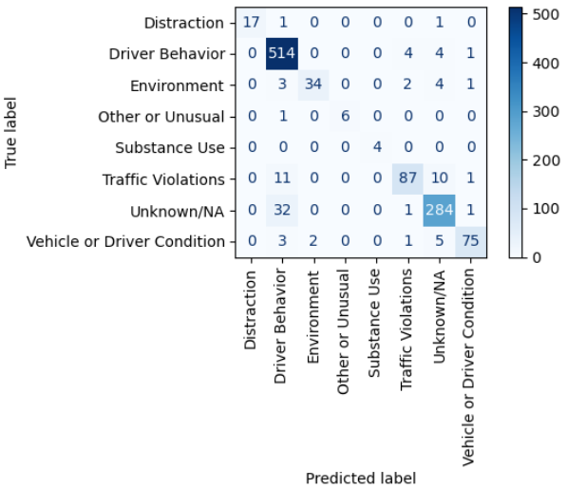
XGBoost results
From the confusion matrix the driver behavior and the unknown as well as the traffic violation are well predicted. from the ROC curve it can be understood that all the classes have good results, because their AUC value are very high. Meaning that the true positive are high with increases the model accuracy.

Slide 9
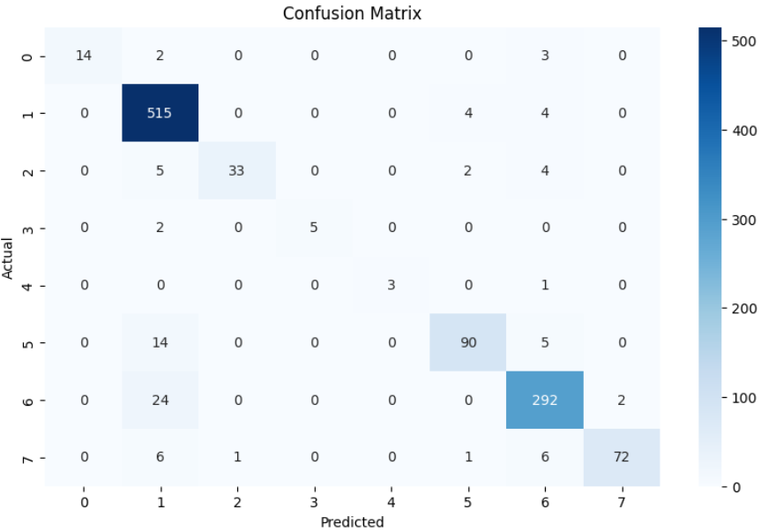
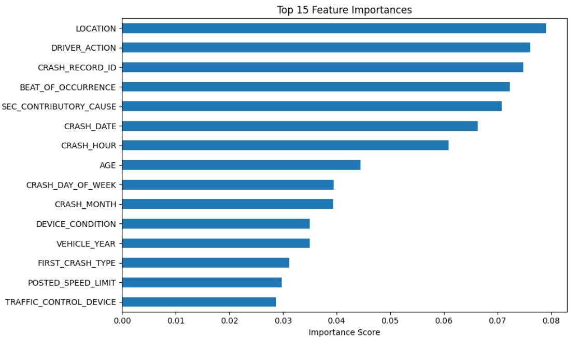
Random Forest results
From the feature importance the driver action and location are considered to be the most influential in the model prediction.

Slide 10
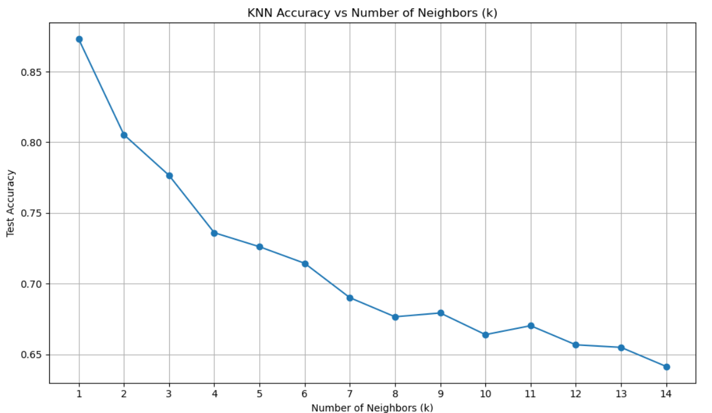
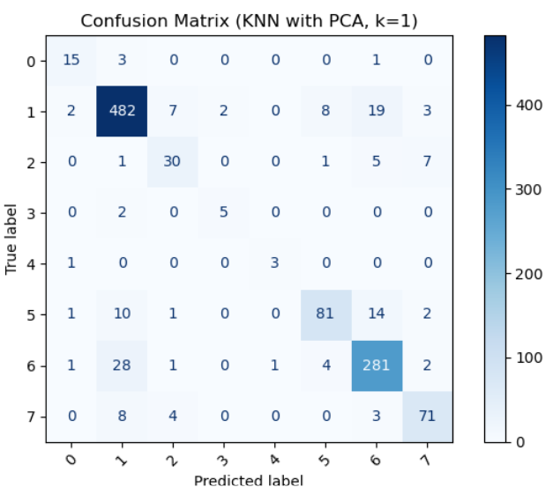
KNN results
From the graph it can be understood that the K=1 has high accuracy. According to the confusion matrix the class 1 has high predictability.

Slide 11
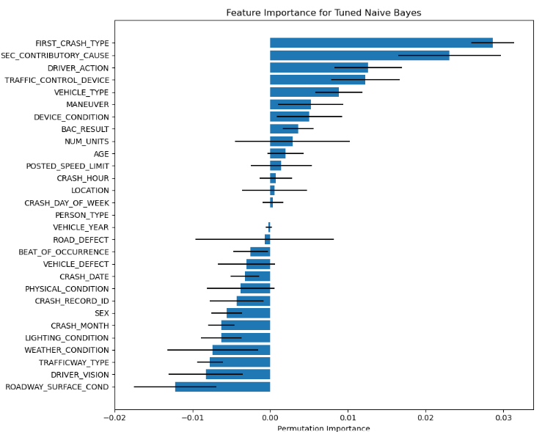
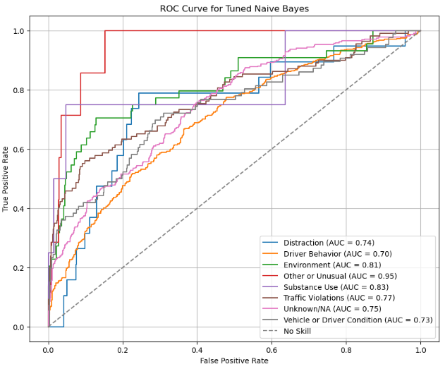
Naive Bayes results
From the Feature importance, the crash type and the secondary cause for crash seem to have more influence in the prediction. From the ROC graph it can be seen that some features like unusual and substance use have high AUC value.

Slide 12
Conclusion
XGBoost and Random Forest are the best performing model with the best level of primary cause prediction out of the evaluated models.
The feature importance was analyzed for Random Forest to understand which causes are considered as major accident causes.
Location and Driver action are considered the major causes for accidents that happen upon drivers.
For XGBoost the model performed well and all the different causes resulted in a high AUC. Indicating that the model was able to learn and based on the data differentiate the different causes.
Conclusion & Recommendation

Slide 13

Thank You!
Any Question?

